Slide 1
AMERICAN PRINTING HOUSE
THE FUTURE BELONGS TO EVERYONE
A P H . O R G
C S U N M A R C H 2 0 1 8

Slide 2
The Challenges of Producing Math and Science Textbooks in Braille
Rebecca Luttmer
Programmer III
APH

Slide 3
Overview of Topics
Why is formatted braille important?
Challenges to getting formatted braille to all students
Introduction to BrailleBlaster
Challenges of producing STEM materials in braille
Introduction to the math tools in BrailleBlaster
Live demo of the math tools

Slide 4
Formatted Braille
Formatting information is crucial to understanding.
Sighted students understand the layout by quickly and easily glancing at a page. Students with visual impairments need to be able to do the same by touch.
Page numbers, titles, sub-titles, footnotes, and more all need to be laid out in an organized fashion so that the student with visual impairments can find information quickly.
It is a skill set that can be carried from subject to subject, book to book and helps the student be organized and focused.

Slide 5
Obstacles of Formatted Braille
Takes a great deal of time
Takes a high level of expertise
It can cost a lot of money

Slide 6
BrailleBlaster (BB) Project Goals
2012
Allows students who read braille to have books on the first day of class—like their sighted peers
Increases output from transcribers
Decreases translation time
Reduces cost in braille production
BrailleBlaster provides more braille in the classroom
Our goals have expanded to include tools for casual users and para-professionals.

Slide 7
NIMAC
Individuals with Disabilities Education Act (IDEA) 2004
Online file repository with 48,000 files meant to be used to create accessible materials

Slide 8
NIMAS
File format found in the NIMAC
BrailleBlaster takes advantage of the rich markup contained in NIMAS files to automate basic formatting
Lists
Headings
Tables
MathML

Slide 9
Specialized Tools
Even without a NIMAS file, BB provides specialized tools to make transcription easier
Table editor
Poetry toolbar
Transcriber note toolbar

Slide 10
Automatic re-translation and re-formatting
Re-flow page numbering
Re-format styles
Example: A list that has blank lines before and after will have them removed if it falls at the first line of a page after reformatting.

Slide 11
STEM (Science, Technology, Engineering, Math)
Growing need for STEM professionals
Benefits
Higher wages
Higher employment
Obstacles for visually impaired students
Public perceptions
Visual-based learning norms
Lack of materials
Notes:
“STEM 101: Intro to tomorrow’s jobs” Occupational Outlook Quarterly • Spring 2014 https://www.bls.gov/careeroutlook/2014/spring/art01.pdf p. 3

Slide 12
Obstacles to getting STEM Materials in Braille
As with literary braille, there are multiple braille codes for STEM braille
Nemeth
UEB Math
States, counties, school districts, even teachers can teach different codes
UEB Math leaves room for a lot of creativity based on student, teacher, or transcriber preferences.

Slide 13
Spatial Representation of Mathematical Concepts
Spatial representation is used to teach the following:
Matrices
Tables
UEB Math
3D modeling

Slide 14

Why is Spatial Representation important?
Math is based on groupings and order of operations
Complex math requires working on a grouping while keeping its relation to another group in mind
Braille provides a way to help keep these group relations distinct

Slide 15
Spatial Representation of Mathematical Concepts
It is dependent on vertical and horizontal positioning.
In literary braille, there is a clear separation of translation and formatting. Translation is done without care for positioning, only order. Formatting provides the positioning information. (Example: Indentation of a nested list)
In STEM, translation and formatting are dependent.

Slide 16
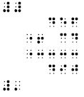
Spatial Representation Translation and Formatting Combined 456+34 = 490

Slide 17
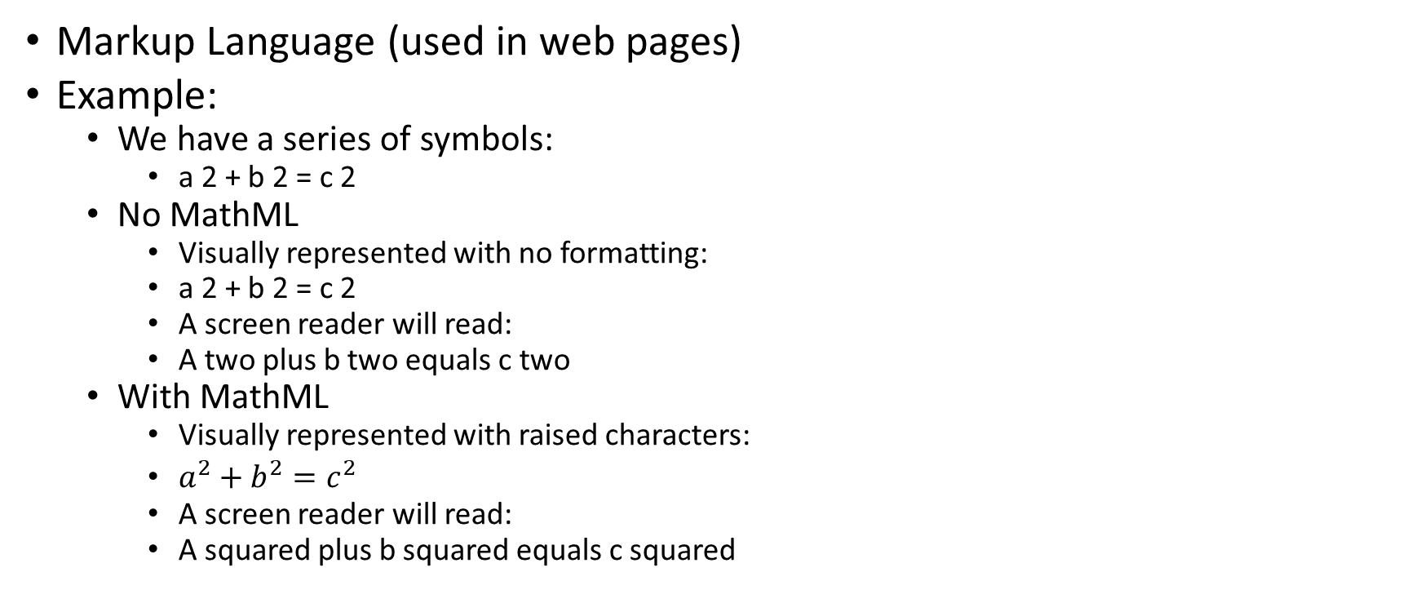
What is MathML?
Markup Language (used in web pages)
Example:
We have a series of symbols:
a 2 + b 2 = c 2
No MathML
Visually represented with no formatting:
a 2 + b 2 = c 2
A screen reader will read:
A two plus b two equals c two
With MathML
Visually represented with raised characters:
$a^{2}+b^{2}=c^{2}$
A screen reader will read:
A squared plus b squared equals c squared

Slide 18
Why is MathML useful?
Retains contextual information such as “squared”
It allows BB to go from UEB Math to Nemeth, Nemeth to UEB Math with Liblouis libraries
If you have a NIMAS file with MathML, we will format for you. If you do not, you can tell BrailleBlaster one time and we can create MathML for you and present it to you in different formats.

Slide 19
ASCII Math
Easy
Root, frac, sin
Editable
Type in the print view and mark as math translation
Accessible
Completely text-based in the print view
Screen reader friendly MathJax image

Slide 20
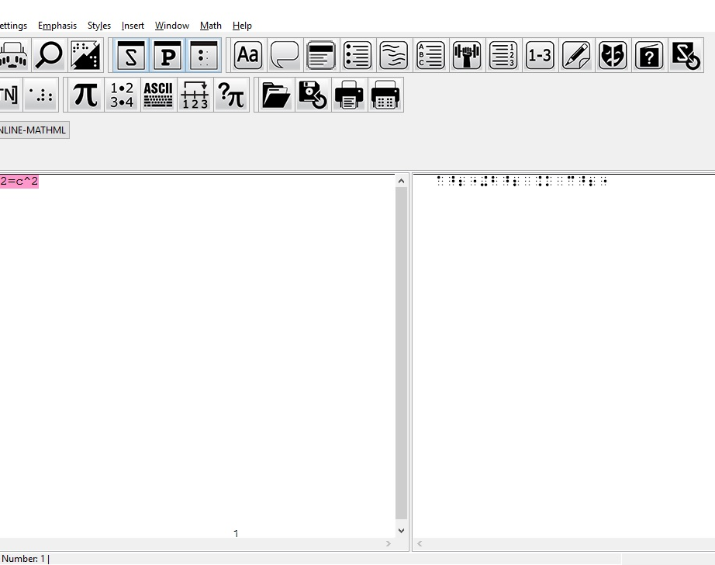
ASCII Math Image

Slide 21
ASCII Math Editor
Easy lookup of ASCII Math by category
English word, ASCII symbol, visual image side by side
As you type, a screen reader friendly MathJax rendering is shown below your ASCII Math
Examples of more complicated math symbols

Slide 22
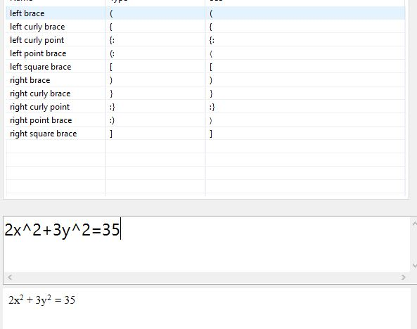
ASCII Math Editor Image

Slide 23
Multiline Math
Math in Tables
UEB Number Line Editor
Matrix Builder
Spatial Math Templates

Slide 24
Math in Tables
Translate table cells into Nemeth or UEB Math
Uses existing table editor functionality

Slide 25
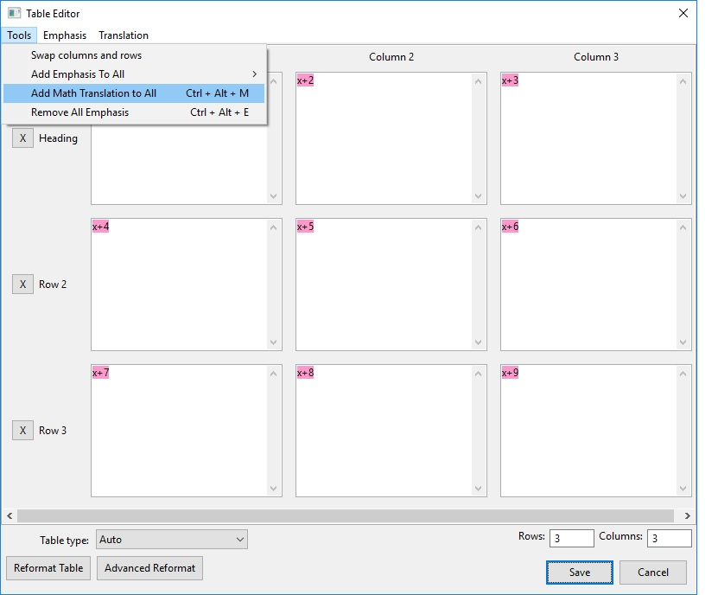
Math in Tables Image

Slide 26
UEB Number Line Editor
UEB Number Line Editor does the work of fitting the line on the page for you
Enter points and end types

Slide 27
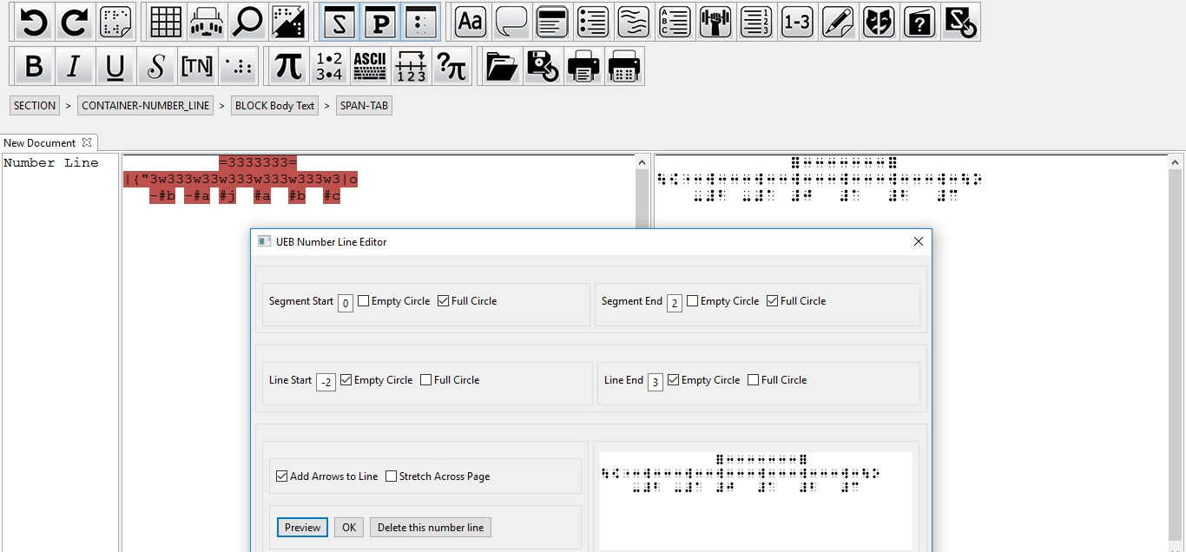
UEB Number Line Editor Image

Slide 28
Matrix Builder
Enter text as math
Choose your brackets –
Square, round, curly, straight
Choose your overflow type –
Block and blank line
Indent columns
A matrix will be created according to your page settings

Slide 29
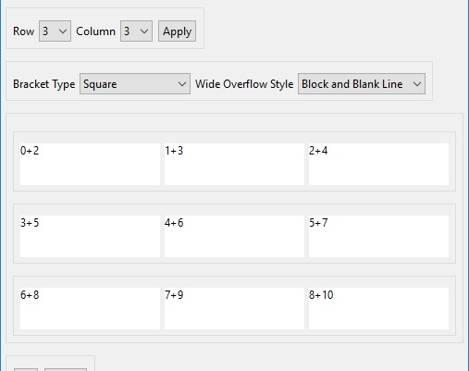
Matrix Builder Image

Slide 30
Spatial Math Templates
Audience – parents and teachers who don’t know braille can pick a template for spatial math
Fill in numbers
Choose operators
Formatting will happen automatically

Slide 31
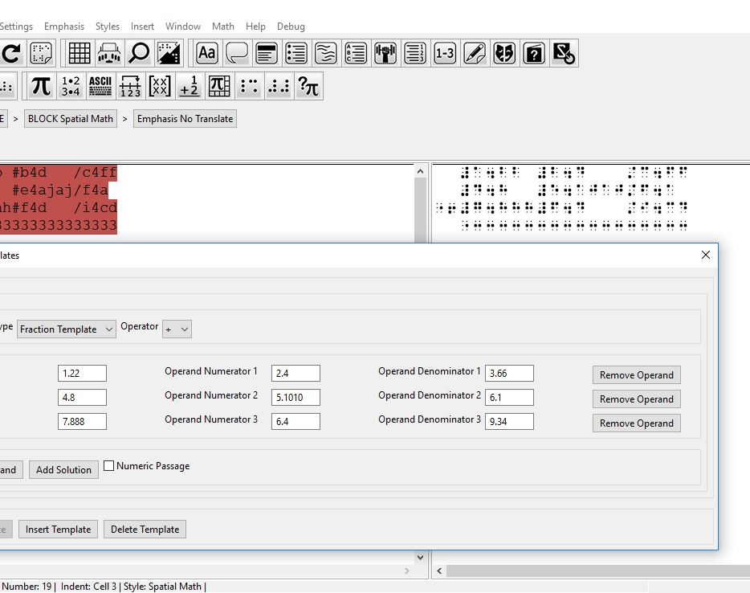
Spatial Math Template Image

Slide 32
Manual Translation
Sometimes technology fails
No text
No MathML
Incorrect MathML
Only images
Bad translation
BrailleBlaster accounts for this and lets the user enter braille manually

Slide 33
Six Key Entry
Multi-line dialog
Multi-purpose
Your six keyed text will be blocked off, and it will be repositioned when the page numbering needs to reflow with the rest of the document

Slide 34
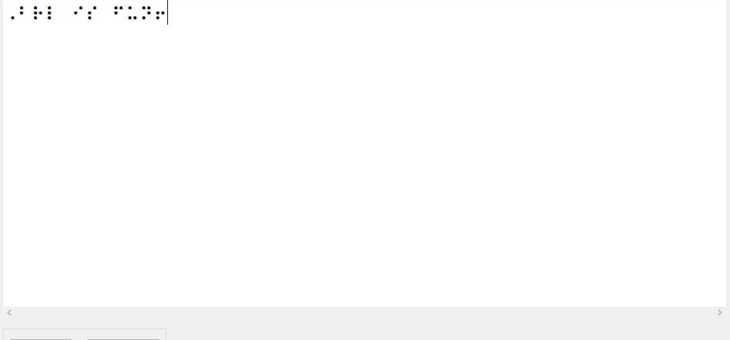
Six Key Entry Image

Slide 35
Image Describer
Math is often embedded in files as images
Finds the images in your NIMAS file
Side by side six key dialog and image

Slide 36
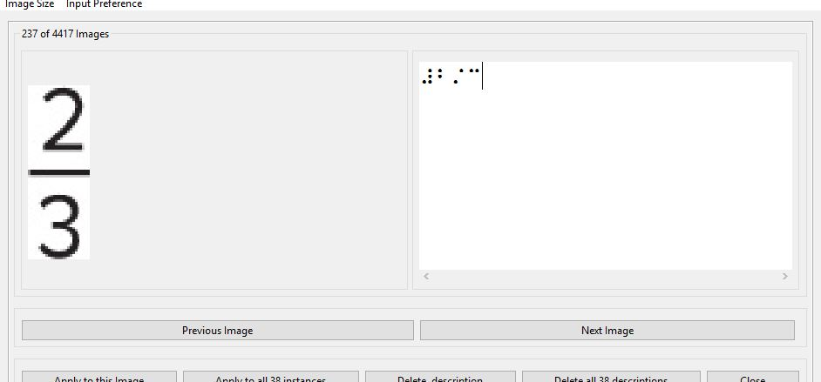
Image Describer Image

Slide 37
Live Demo

Slide 38
BrailleBlaster is free and available now!
http://brailleblaster.org/
Download BrailleBlaster
Learn more about bringing NIMAS and MathML to your school district
Watch tutorial videos
Read Documentation
Download BrailleZephyr
Become a beta tester
Contact us!

Slide 39

The Challenges of Producing Math and Science Textbooks in Braille
Rebecca Luttmer rluttmer@aph.org

